Slide 1

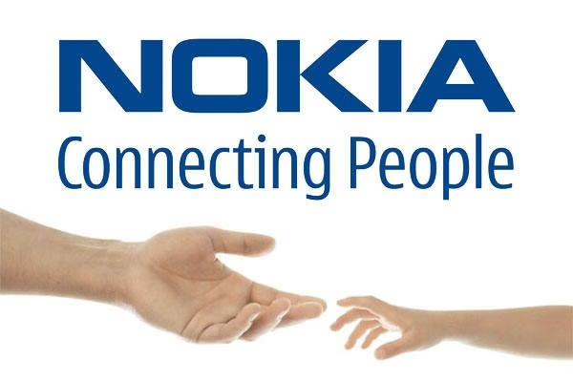

Nokia: A Legacy of Innovation
Nokia is a Finnish multinational telecommunications, information technology, and consumer electronics company. Founded in 1865, Nokia has a long history of innovation and technological advancements. The company has been a global leader in mobile phones, network infrastructure, and other technologies.

Slide 2
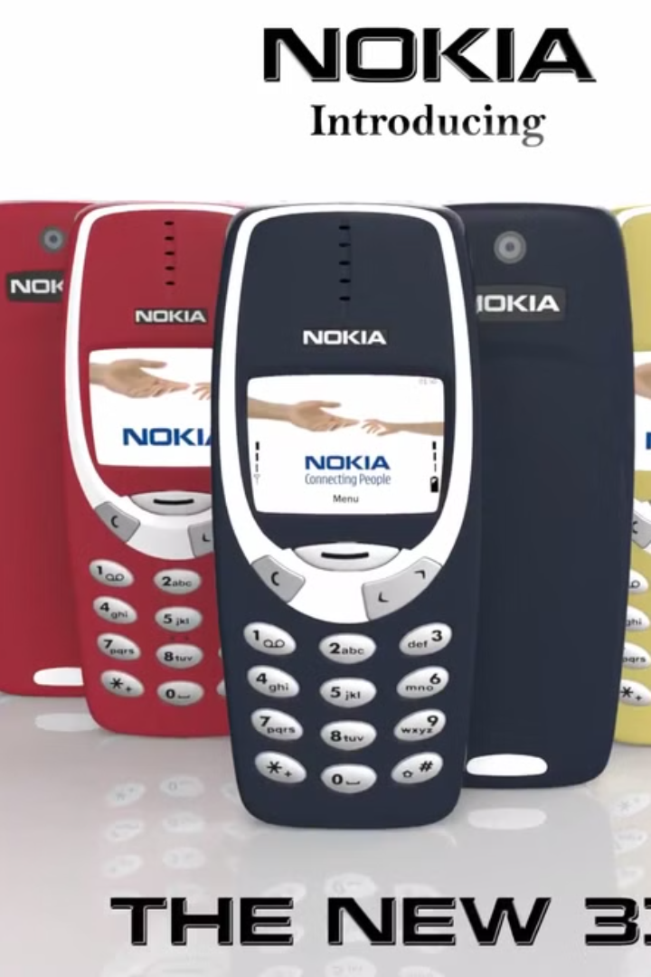
Brand Introduction
1
Connecting People Since 1865
Nokia was founded in 1865 in Finland as a paper mill.
2
Global Leader in Telecommunications
Nokia transitioned from a paper mill to a global leader in telecommunications.
3
Renowned for Innovation
Nokia is renowned for mobile phones, network infrastructure, and technological innovation.
4
Brand Slogan
Nokia's brand slogan is "Connecting People."

Slide 3

Meet the Team
Name
Responsibilities
MD Muhtakim Safat Mishon
Slides 1-2
Marwan Ibna Alam
Slides 3-4,5
Muntaher Irfan
Slides 6-7
Naimul Idrish Sayem
Slides 8-9
Samiul Maruf
Slide 10
Pronab Dey
Slide 11
Shahed Akbor Pial
Slide 12
Sumaiya Nur Jaman
Slide 13
Mohammad Saimun
Slide 14

Slide 4
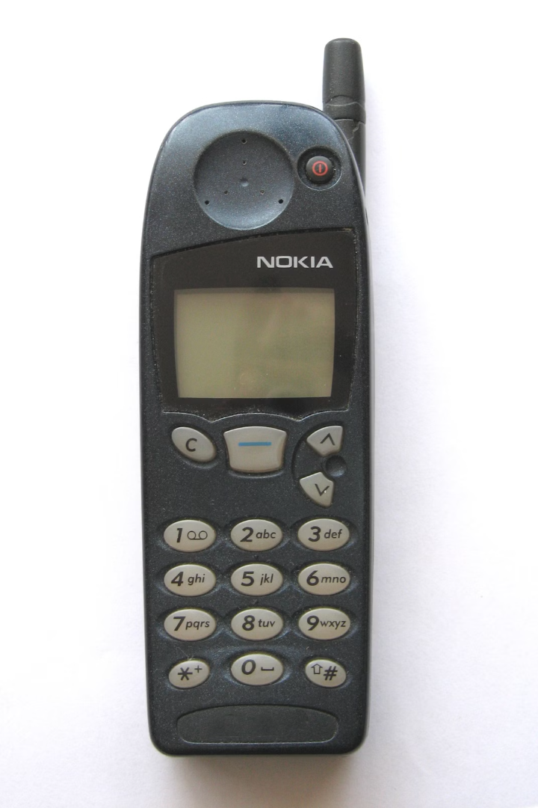
Brand Journey and Purpose
1
1865: Founded as a Pulp Mill
Nokia was founded as a pulp mill in Finland.
2
1960s: Entered the Electronics Industry
Nokia entered the electronics industry in the 1960s.
3
1980s-1990s: Global Leader in Mobile Phones
Nokia became a global leader in mobile phones in the 1980s and 1990s.
4
2000s: Transition to Network Infrastructure
Nokia transitioned to network infrastructure in the 2000s.
5
Today: Innovating in 5G, IoT, and Digital Health
Today, Nokia is innovating in 5G, IoT, and digital health.
6
Purpose: To Connect the World
Nokia's purpose is to create technology that connects the world.

Slide 5
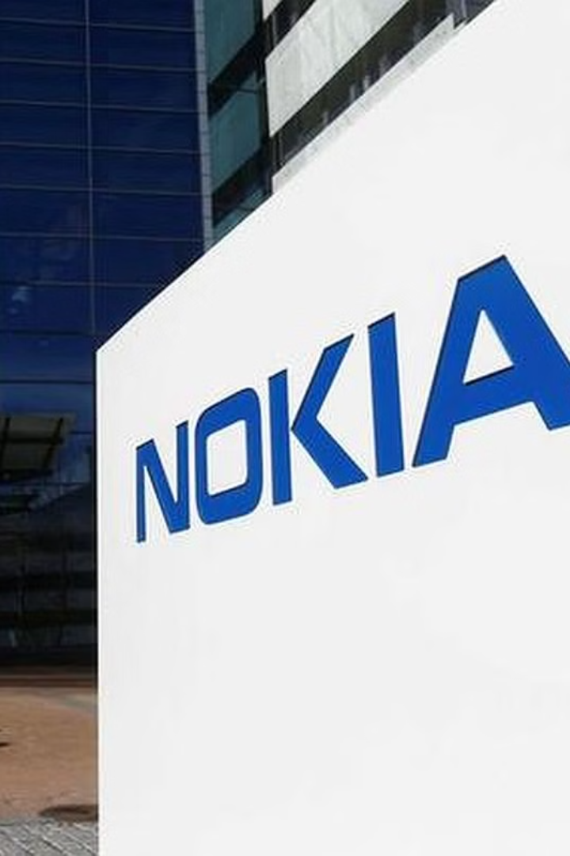
Outlets and Manufacturing Unit Locations
Nokia's headquarters is located in Espoo, Finland.
Nokia has manufacturing units in Finland, India, China, Brazil, and Vietnam.
Nokia has over 40 R&D centers across the globe.
Nokia is present in over 130 countries with retail outlets.

Slide 6
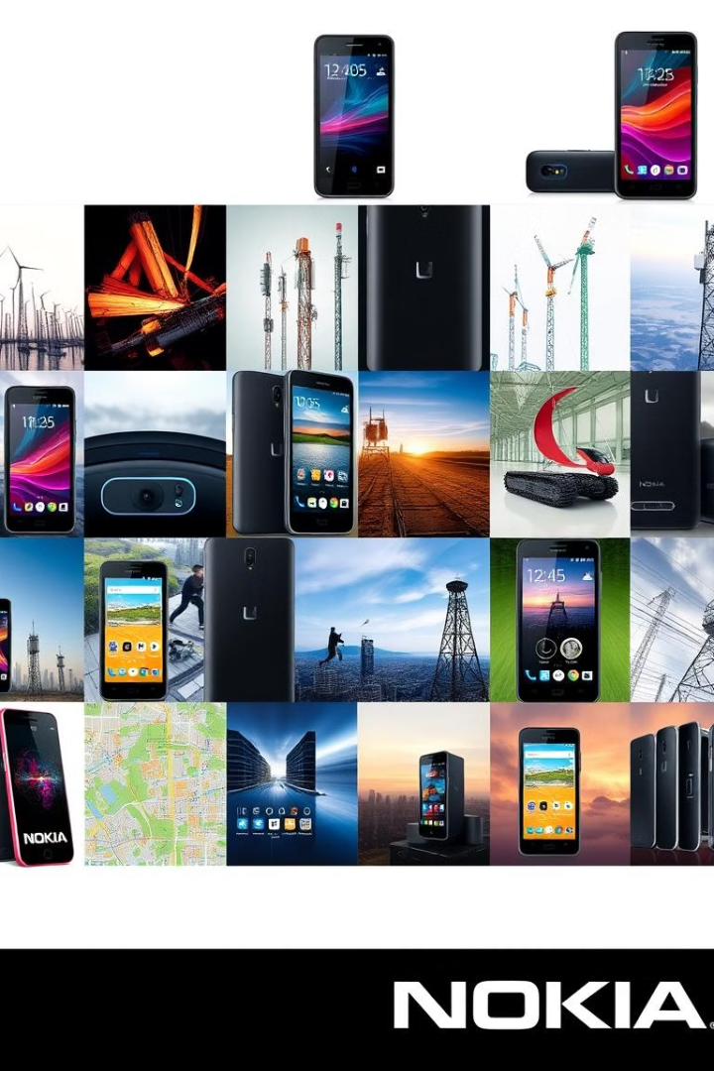
Products and Services
Nokia offers a wide range of products and services, catering to both consumers and businesses.
1
Smartphones
Nokia offers a range of smartphones with various features and price points.
2
Network Infrastructure
Nokia provides network equipment for telecommunications companies, including 5G, 4G, and fiber optic solutions.
3
Digital Mapping Services
Nokia offers location-based services and data, including maps, navigation, and traffic information.
4
Cloud Solutions
Nokia provides cloud-based services and infrastructure for businesses.

Slide 7

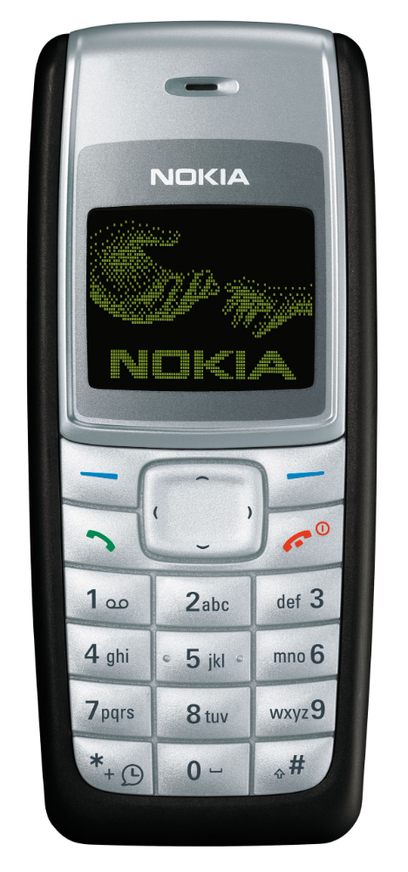
Merits and Drawbacks
Merits
Drawbacks
Strong brand legacy
Struggled with smartphone market competition
Pioneers in 5G technology
Global network infrastructure leader
Late entry into the smartphone OS wars
High-quality, durable products
Facing strong competition in the 5G sector

Slide 8
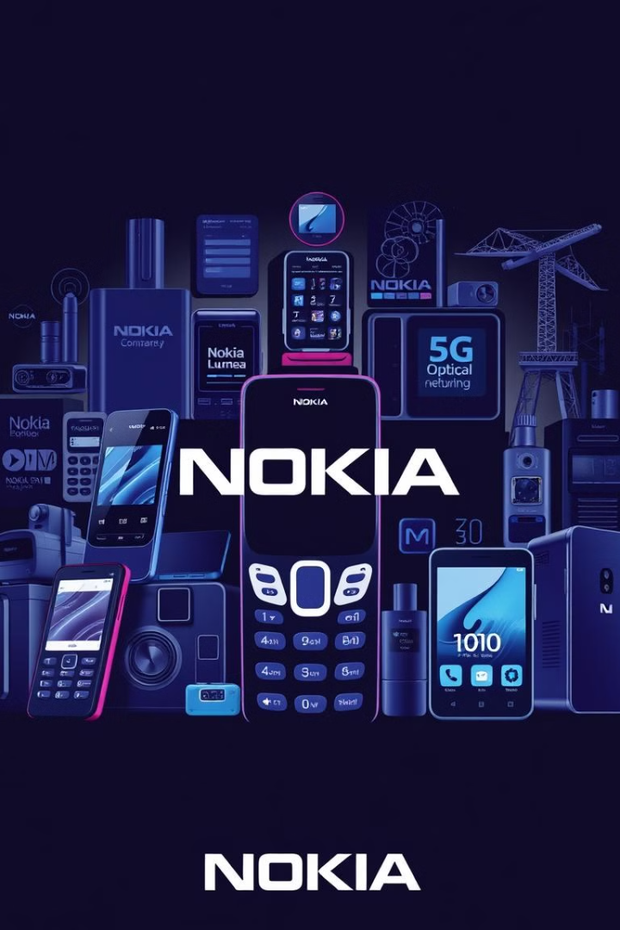
Best Selling Services / Products
1
Best-Selling Mobile Phones
Nokia's best-selling mobile phones include the Nokia 1100, Nokia 3310, and Nokia Lumia series.
2
Top Network Solutions
Nokia's top network solutions include 5G infrastructure and optical networking.
3
Leading Services
Nokia's leading services include network automation and cloud services.

Slide 9

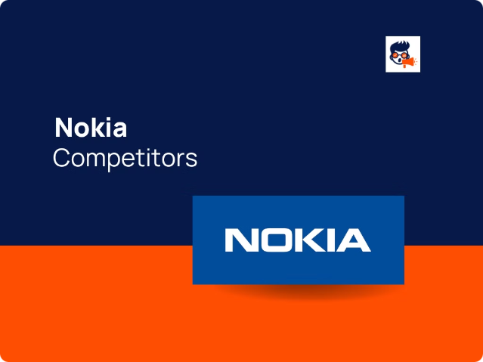
Competitors
Market
Competitors
Mobile Phones
Samsung, Apple, Huawei, Xiaomi
Network Infrastructure
Ericsson, Huawei, Cisco, ZTE
Digital Health
Fitbit, Apple, Samsung

Slide 10
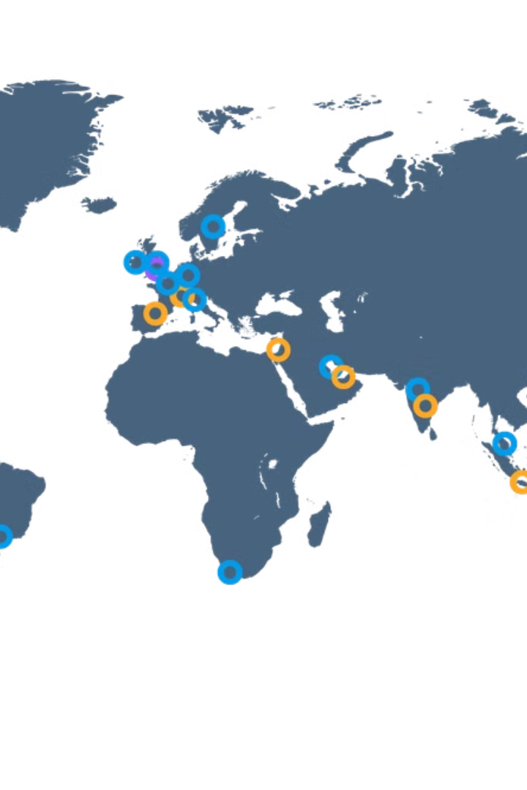
Sales and Marketing
1
Focus on Emerging Markets
Nokia focuses on emerging markets for sales and marketing.
2
Digital Marketing Campaigns
Nokia utilizes digital marketing campaigns to reach its target audience.
3
Partnerships with Telecom Operators
Nokia partners with telecom operators to expand its reach and distribution.
4
Sponsorships and Brand Ambassador Programs
Nokia engages in sponsorships and brand ambassador programs to enhance brand visibility.

Slide 11
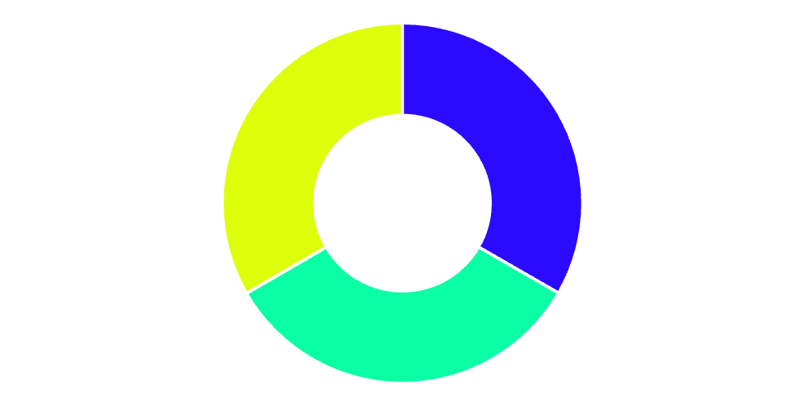
Profit and Loss Charts of Last 2-3 Years
1
2
3
2021
2022
2023
Revenue: €22.2 billion
Revenue: €23.2 billion
Revenue: €24.5 billion (estimated)
Operating Profit: €2.2 billion
Operating Profit: €2.8 billion
Net Income: €1.6 billion
Net Income: €2.1 billion
Operating Profit: €3.0 billion (estimated)
Net Income: €2.4 billion (estimated)(estimated)
€1.6 billion
€2.1 billion
€2.4 billion

Slide 12



Commitment to Sustainability
Sustainability Initiatives
Eco-Friendly Practices
Sustainability Goals
Investing in solar and wind power for manufacturing facilities
Robust recycling programs for paper, plastics, and e-waste
Achieve carbon neutrality across all operations by 2030
Transitioning to energy-efficient LED lighting and appliances
Reduce electronic waste by 50% through responsible disposal and recycling
Optimizing logistics and transportation to minimize carbon emissions

Slide 13


Recognitions and Achievements
1
Recent Awards
Global Mobile Award for Best Network Infrastructure (2023)
2
Certifications
ISO 14001 for environmental management, ISO 9001 for quality management
3
Accolades
Recognized as a leader in 5G innovation by multiple industry bodies

Slide 14
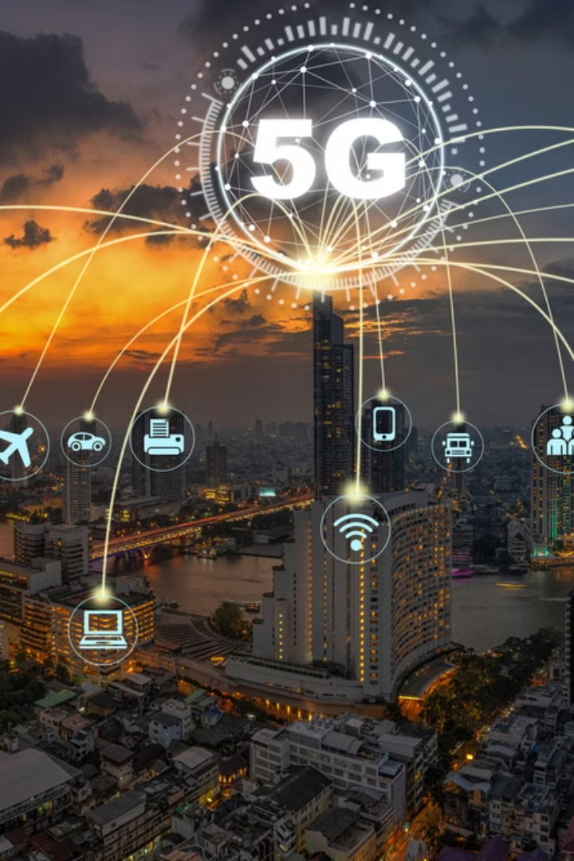
Vision for the Future
1
5G and Beyond
Leadership in 5G expansion and research into 6G technology
2
Digital Transformation
Expanding IoT solutions, AI integration, and smart city projects
3
Sustainability
Ongoing commitment to reducing environmental impact
4
Global Connectivity
Bridging the digital divide with affordable solutions

Slide 15

Thank You!

Slide 16


